Slide 1
User Interface Design Principles
Bernardo Nugroho Yahya

Slide 2
Agenda
User Interface Design Principles
Template
Summary

Slide 3
User Interface Design Principles
Layout: the interface should be a series of areas on the screen that are used consistently for different purposes: navigation (top area), input and output (middle area) and system status (bottom area)
Content awareness: user should be aware of where they are in the system and what information is being displayed
Aesthetics: interface should be functional and inviting to users through the careful use of white space, colors and fonts

Slide 4
User Interface Design Principles
User experience: some users will prefer ease of learning and some will prefer ease of use
Consistency: it enables users to predict what will happen before they perform a function
Minimize user effort: the user interface should be simple to use

Slide 5
Structure of a User Interface
Navigation mechanism: the way in which the user gives instructions to the system and tells it what to do (buttons, menus)
Input mechanism: the way in which the system captures information (Web forms etc.)
Output mechanism: the way in which the system provides information to the user or to other systems (reports, Web pages)

Slide 6
User interface evaluation
Objective of user interface evaluation: to understand how to improve the user interface design
Methods:
Expert reviews: conducted in the presence of human factors specialists and consist of a combination of standard inspection methods (in this case,
Heuristic evaluation, cognitive and pluralistic walkthroughs, and consistency and standards inspections) all bundled into one inspection session
Reviews: conducted by end users
Usability Testing
Criteria list - comparison

Slide 7
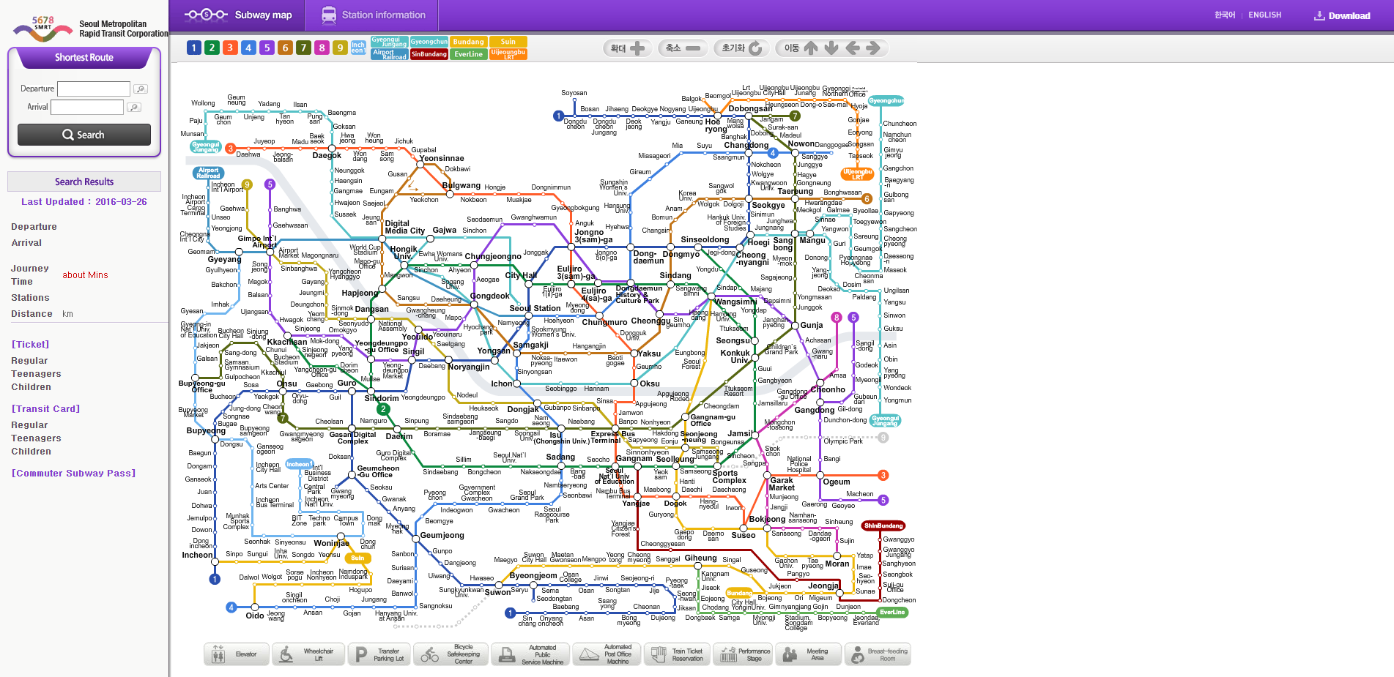
Digital collection user interfaces

Slide 8
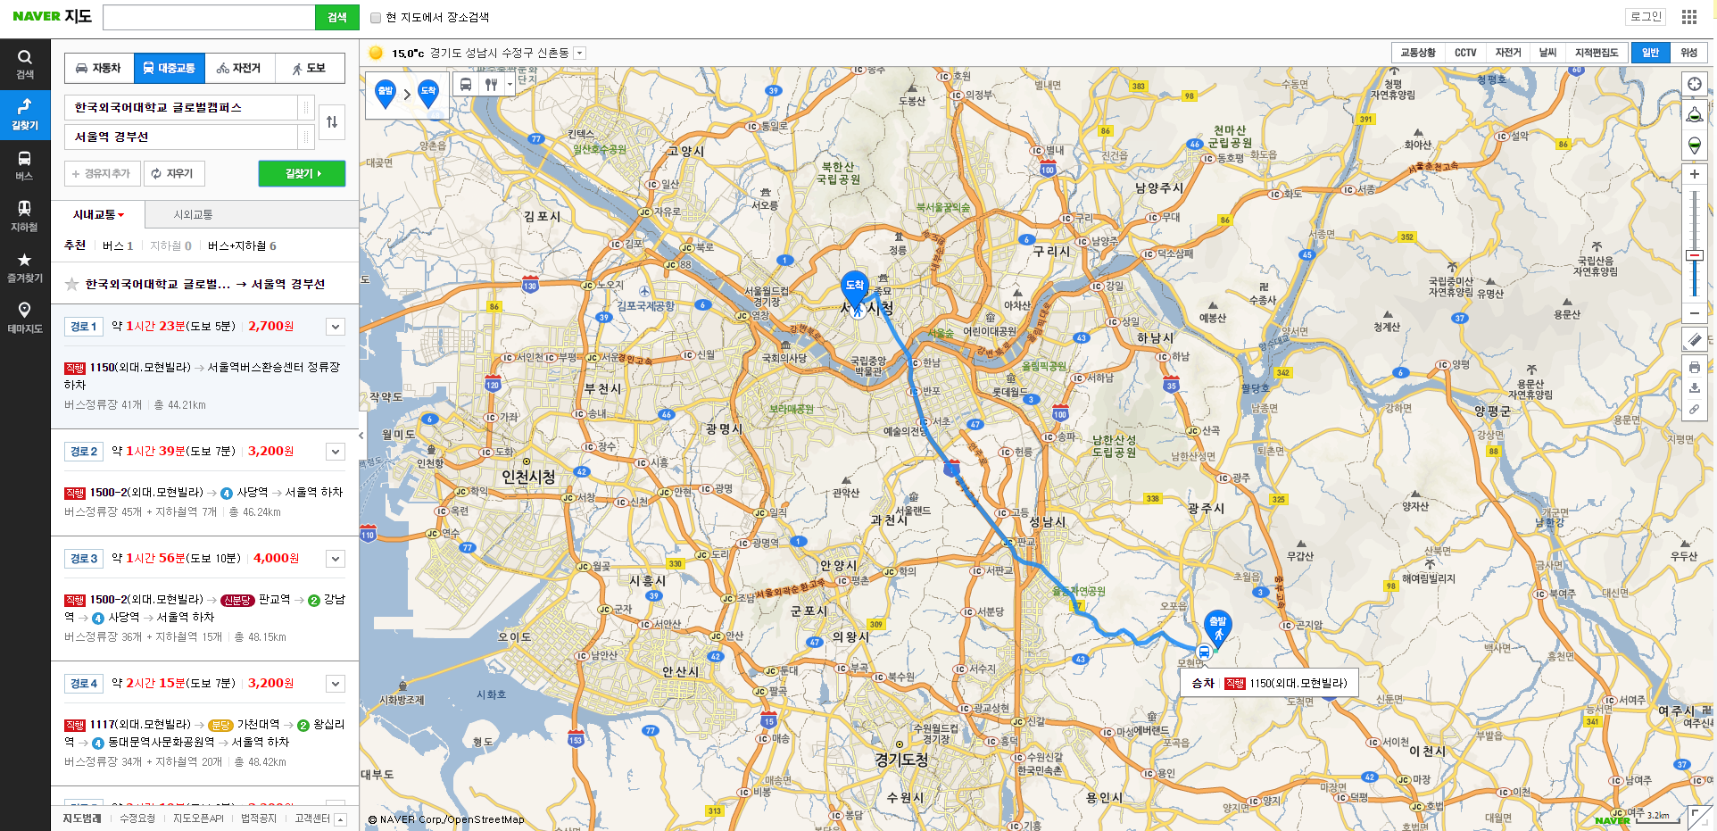
Digital collection user interfaces

Slide 9
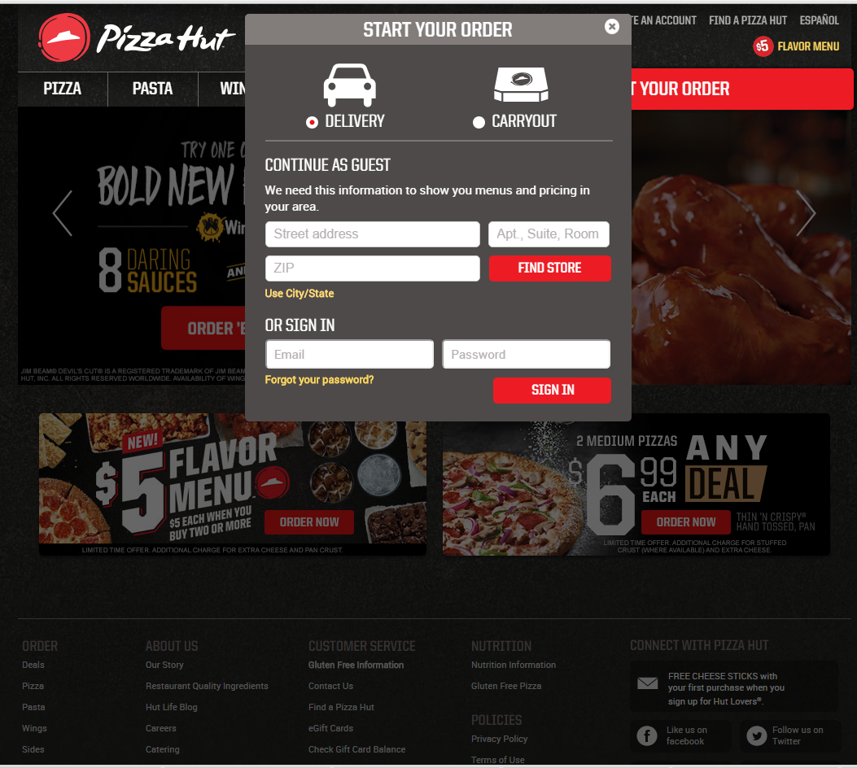
Digital collection user interfaces

Slide 10
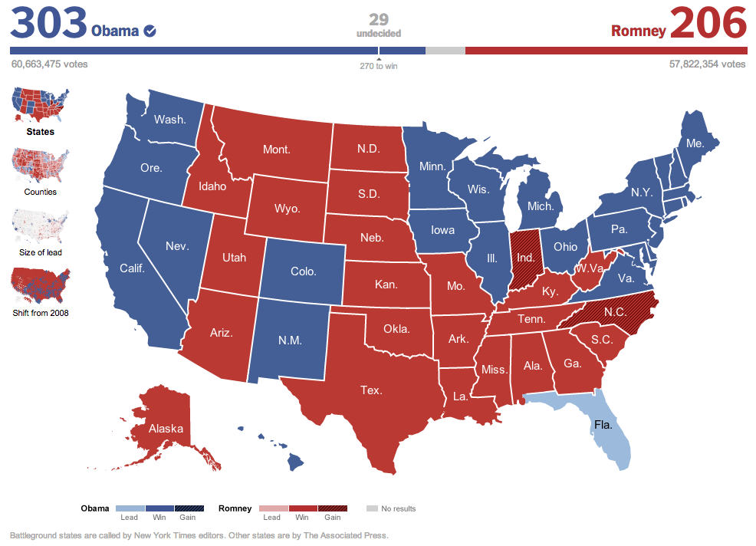

Slide 11
Who? What? Should?
Who is my audience?
Experts?
Students?
General public?
What do I want to tell them?
Space or time relationship?
Multivariate system?
Does this message belong in a visualization?
Notes:
----- Meeting Notes (6/28/11 16:48) -----
Can it be summarized in some other way? Or is the visual summary the right way to go?

Slide 12
How to Get Started
Get some data.
Organize and structure the data.
Remove unnecessary(!) data.
Use statistical methods to discover patterns.
Choose a visualization style.
http://www.visual-literacy.org/periodic_table/periodic_table.html
Refine.
Build interaction, if appropriate and possible.

Slide 13
Visualization Playgrounds
Open Data of Korean Government
https://www.data.go.kr/
OpenData
http://opendata.socrata.com/
ChartsBin
http://chartsbin.com/graph
Notes:
Many Eyes:
Open Data: Food Recalls
ChartsBin: very geo focused, journalists in prison worldwide

Slide 14
Template
Building your own Cascading Style Sheet (CSS)
The use of template
Finding existing CSS
Existing Template. For example: https://speckyboy.com/2014/12/15/top-50-web-mobile-gui-templates-2014/

Slide 15
Summing Up
Make sure data visualization is the right tool for the job
Define audience, information to communicate first
Choose a visualization
Existing examples in knowledge area?
Data to support this visualization?
Tools and expertise to create it?
Have fun
Try breaking some rules
Ask someone outside of your area for feedback!

